Slide 2
Color Detection
Application

Slide 3
Supervised by: Prof. Narendra Pal Singh Rathore
Team Members
1. Ajay Singh Dangi
2. Aman Kanungo
3. Amitesh Mishra

Slide 4
Project Presentation Outline
Abstract
Introduction
Survey of Existing Systems
Objectives
Description
Models and Diagrams
Resources and Limitations
Conclusions and Limitations

Slide 5
Abstract
Building a color Recognizer App using Python, here we are going to build an application through which you can automatically get the name and code of the color by clicking on them.

Slide 6
Introduction
Additionally, we obtain the color name of the pixel along with the composition of three different colors red, blue, and green values. It helps recognize colors and robotics. One of the applications of color detection by computer vision is in driver-less cars. This system is useful in detecting traffic and vehicle backlights and makes decisions to stop, start and continue driving. This also has much application in the industry to pick and place different colored objects by the robotic arm. Color detection is also used as a tool in various image editing and drawing apps.
Probable problems that would be addressed during the project:-
Detection of multi shades color is time-consuming
Paper waste
The difficulty for kids to understand about colors
Color recognition for color blind people.

Slide 7
Introduction
Before going into the speculations of the project it is important to know the definition of color detection. It is simply the process of identifying the name of any color. It is obvious that humans perform this action naturally and do not put any effort into doing so. While it is not the case for computers.
The human eyes and brain work in coordination to translate light into color. Light receptors that are present in the eyes transmit the signal to the brain which in turn recognizes the color. There is no exaggeration in saying that humans have mapped certain lights with their color names since childhood. The same strategy is useful in detecting color names in this project. Three different colors Red, Green, and Blue are being tracked by utilizing the fundamentals of computer vision. After successful compilation when we execute the code a window redirect to the image displayed on it whose path is given as an argument.

Slide 8
Survey of Existing Systems
No. | Existing system/website/software | Features | Disadvantages | Limitations/Gaps
1. | https://imagecolorpicker.com/en | It detects color Code | Does Not Work everytime, We have to click So many times then it shows the color code. | It Doesn't show the name of the color on which the cursor is.
2. | https://pinetools.com/image-color-picker | It shows the accurate position of the cursor. | N/A | It shows unwanted data and also not the color name.

Slide 9
Objectives
Automated color detection systems can be built for color detection which help in the completion of work in less time.
Make children learn about color with just one click with reduction of paper wastage which also leads to a healthy environment.
Learning colors is easy for children, Now they can identify colors with a single click.
Helps color blind people to recognize exact color.
On a large scale, this software can be used for live color detection of objects, walls for paints companies to provide the required color to their customers.

Slide 10
Project Description
To use these modules we have to install the necessary libraries. Library installation is a very easy step using pip. Pip is a package management tool. We will do the installation using the command-line interface.
You can choose any image you want. We will save our image in the same folder as our program, which makes it easier to find and import. First, we have to teach them the colors. To do that we need data that includes color names and some values to match with those colors. Since most of the colors can be defined using Red, Green, and Blue. That’s why we will use the RGB format as our data points.

Slide 11
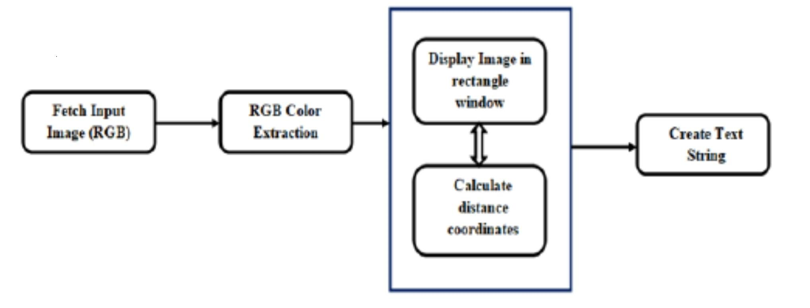
Process Flow Diagram

Slide 12
Resources and Limitations
Hardware Requirements :-
4 GB RAM
<100 GB of Storage
Core i3 Processor
Software Requirements:-
Python
Python Libraries :- numpy pandas opencv-python
Limitations :-
It only shows RGB scale but not HSV scale and HSL scale.
It doesn't show HEX Color Code.

Slide 13
Conclusion And References
In this paper we defined to get the required color field from an RGB image. In this various steps are implemented using the openCv platform. The main positive point of this method is its color differentiation of a mono color. In the future scope, the detection of the edge detection techniques has different other applications like facial detection, color conversion for grayscale image etc. that can also be implemented.
https://imagecolorpicker.com/en
https://pinetools.com/image-color-picker
www.google.co.in

Slide 14
Q&A

Slide 15
THANKS

